Slide 1

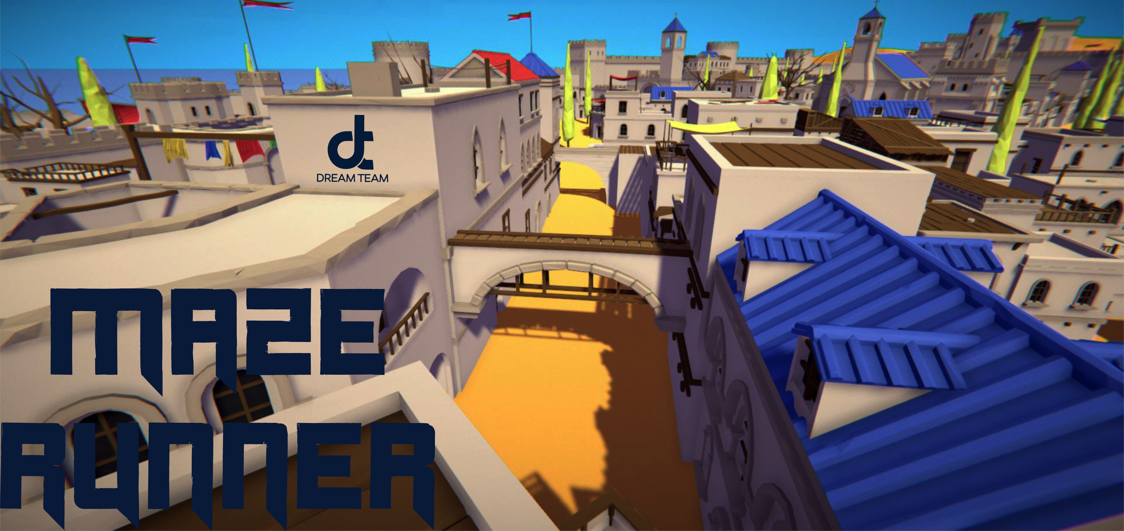

DreamTeam Weekly Status report 4
Presented By: Benjamin Hallman

Slide 2
Progress to date
Player controls and player health system
Automated maze/level generation
Automated moving and attacking enemies
Automated stress testing for the player, enemies, and level generation
Development on sounds, menus, and Item management

Slide 3
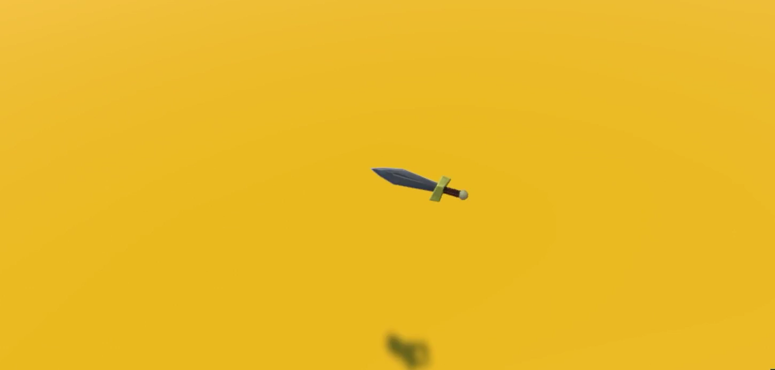
Game demo

Slide 4
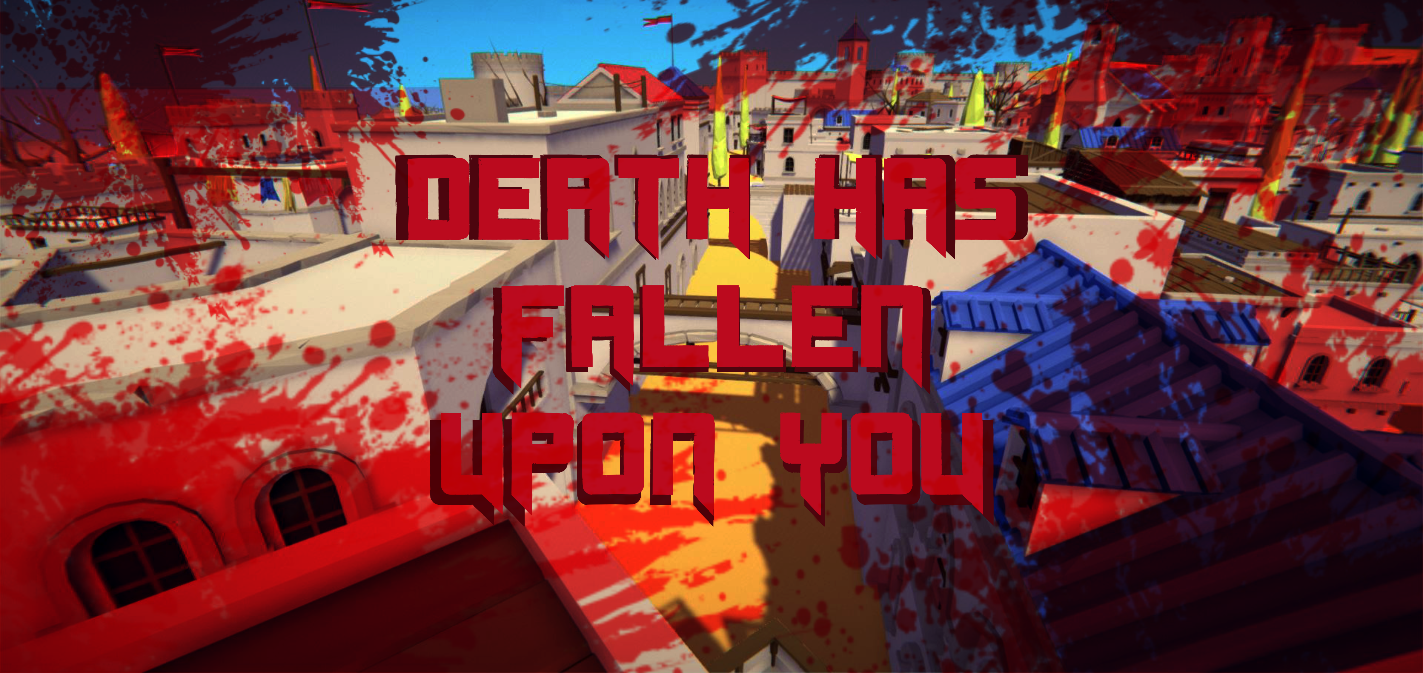
What Have WE Done Since?
Death screen
Player health has been further implemented
Damage overlay now exists
A game over script has been developed and implemented
Began the incorporation of the death screen

Slide 5
What is next?
The master merge
Implementation of the following:
Collision checks and management
Menus, death screen, overlays, and a HUD
Sounds, controller vibrations, and player feedback
Aesthetic map improvements
Beta testing and bug fixes

Slide 6
Master Gantt Breakdown
Meetings
System Analysis
Gantt Chart
Management Summary

Slide 7
Meetings

Slide 8
System analysis

Slide 9
Gantt chart

Slide 10
Management summary

Slide 11
Questions?

